Slide 1
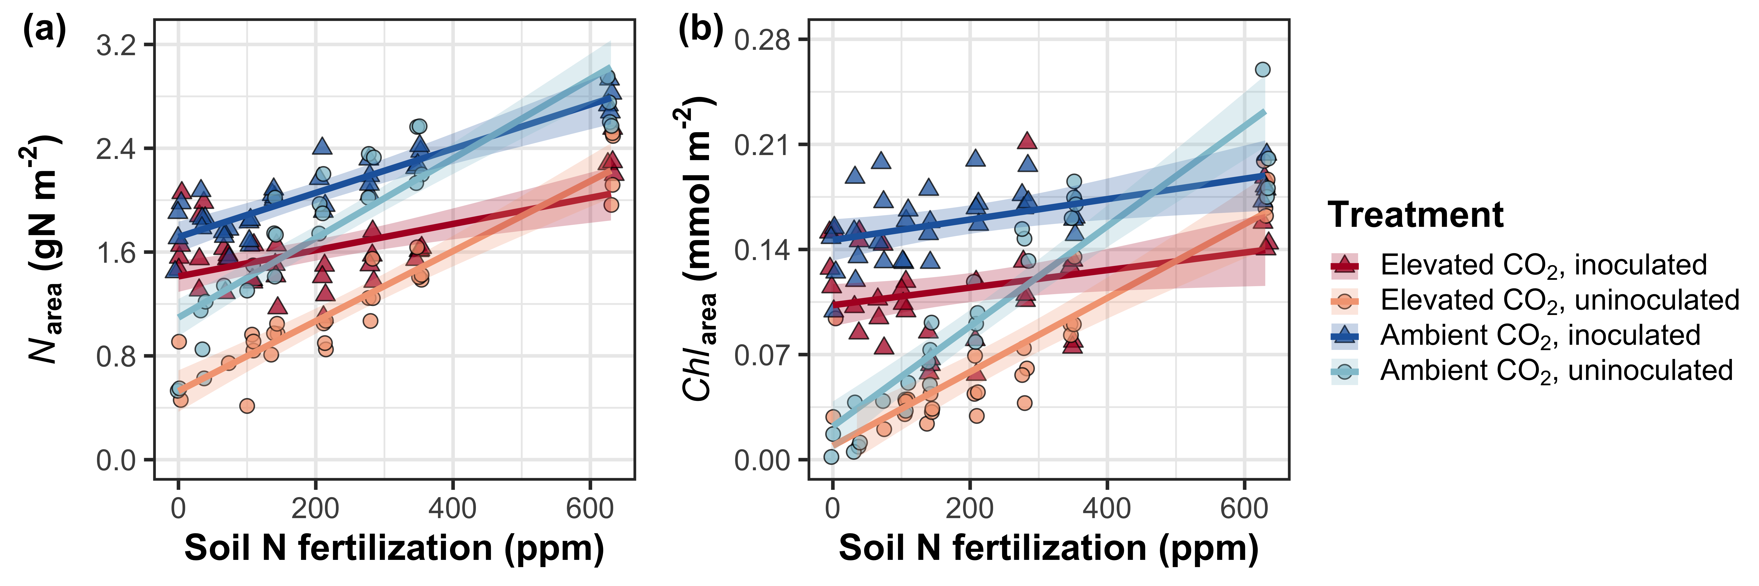
Figure 1. Effects of CO₂ concentration, inoculation, and nitrogen fertilization on leaf nitrogen per unit leaf area (a) and chlorophyll content per unit leaf area (b). Nitrogen fertilization is on the x-axis in both panels. Red shaded points and trendlines indicate plants grown under elevated CO₂, while blue shaded points and trendlines indicate plants grown under ambient CO₂. Light blue and light red circular points and trendlines indicate measurements collected from uninoculated plants, while dark blue and dark red triangular points indicate measurements collected from inoculated plants. Solid trendlines indicate regression slopes that are different from zero (p<0.05), while dashed trendlines indicate slopes that are not distinguishable from zero (p>0.05). Error ribbons of each trendline represent the upper and lower 95% confidence intervals.

Slide 2
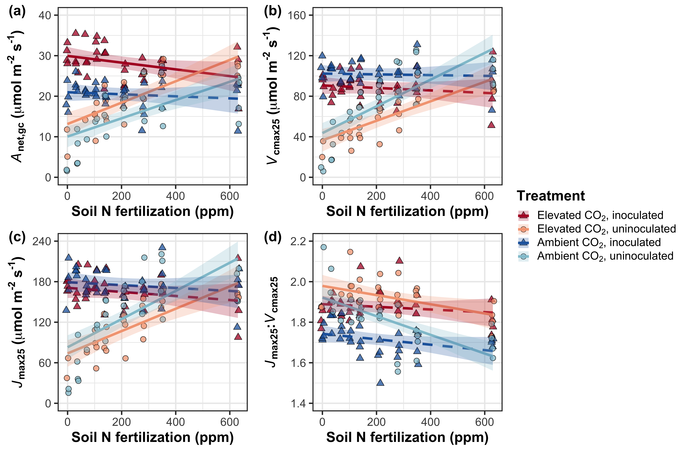
Figure 2. Effects of CO₂ concentration, inoculation, and nitrogen fertilization on net photosynthesis measured under growth CO₂ concentration (a), the apparent maximum rate of Rubisco carboxylation at 25°C (b), the apparent maximum rate of electron transport for RuBP regeneration at 25°C (c), and the ratio of the apparent maximum rate of electron transport for RuBP regeneration to the apparent maximum rate of Rubisco carboxylation (d). Nitrogen fertilization is on the x-axis in all panels. Red shaded points and trendlines indicate plants grown under elevated CO₂, while blue shaded points and trendlines indicate plants grown under ambient CO₂. Light blue and light red circular points and trendlines indicate measurements collected from uninoculated plants, while dark blue and dark red triangular points indicate measurements collected from inoculated plants. Solid trendlines indicate regression slopes that are different from zero (p<0.05), while dashed trendlines indicate slopes that are not distinguishable from zero (p>0.05). Error ribbons of each trendline represent the upper and lower 95% confidence intervals.

Slide 3
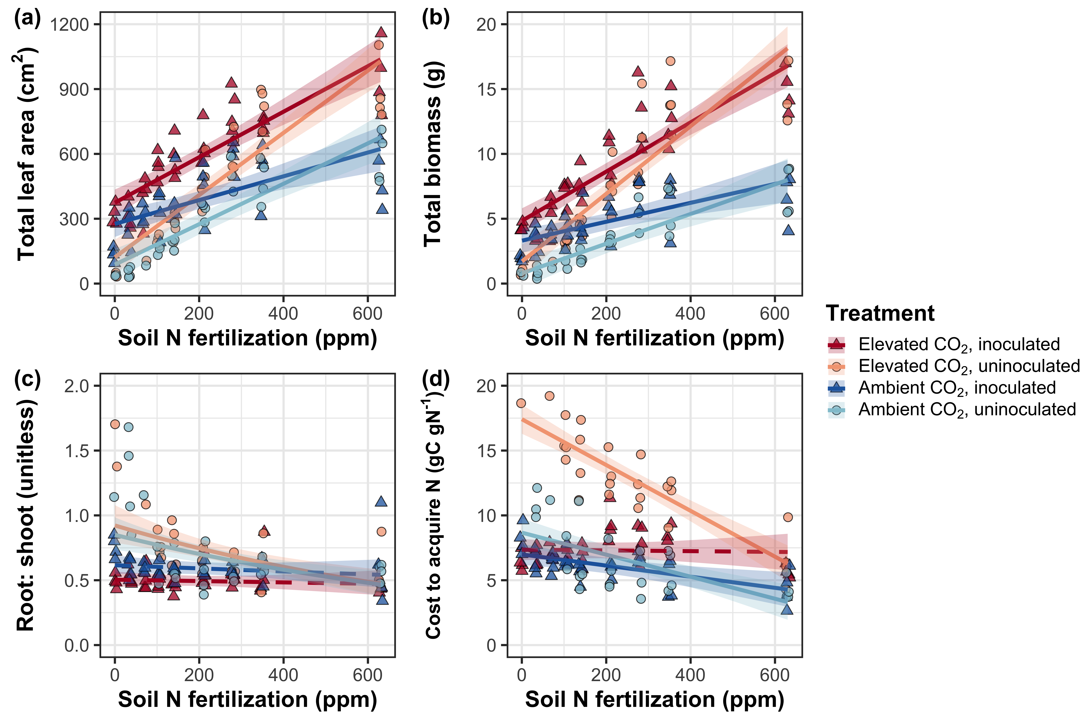
Figure 3. Effects of CO₂ concentration, inoculation, and nitrogen fertilization on total leaf area (a), total biomass (b), the ratio of root biomass to shoot biomass (c), and belowground carbon cost to acquire nitrogen (d). Nitrogen fertilization is on the x-axis in all panels. Red shaded points and trendlines indicate plants grown under elevated CO₂, while blue shaded points and trendlines indicate plants grown under ambient CO₂. Light blue and light red circular points and trendlines indicate measurements collected from uninoculated plants, while dark blue and dark red triangular points indicate measurements collected from inoculated plants. Solid trendlines indicate regression slopes that are different from zero (p<0.05), while dashed trendlines indicate slopes that are not distinguishable from zero (p>0.05). Error ribbons of each trendline represent the upper and lower 95% confidence intervals.

Slide 4
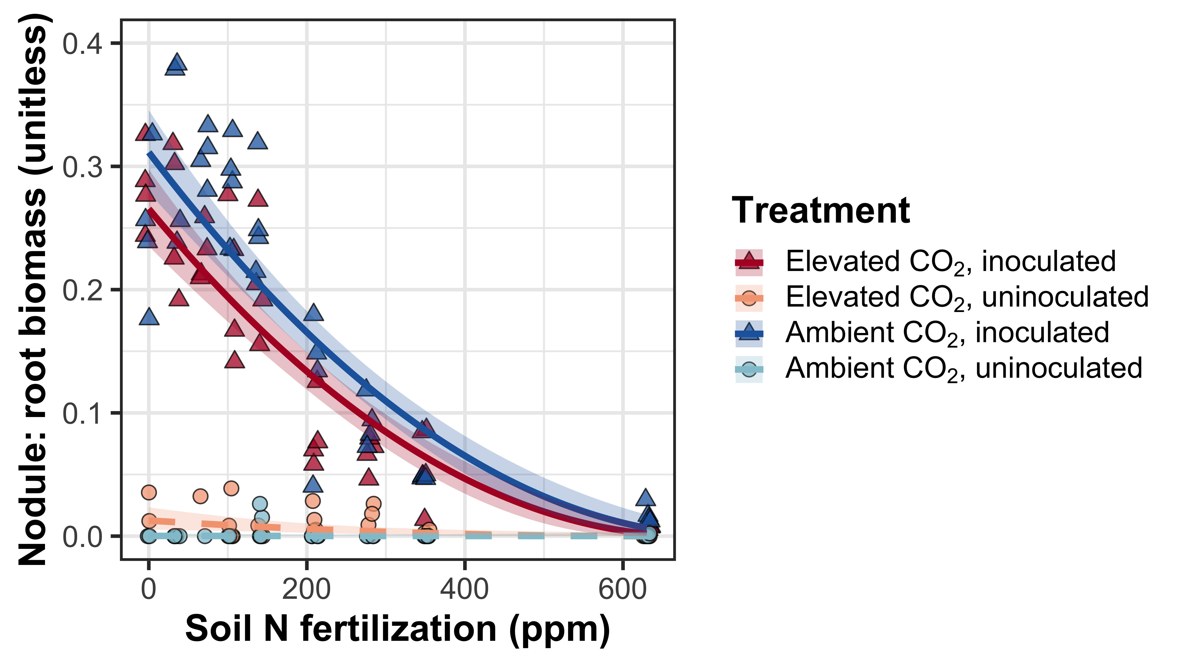
Figure 3. Effects of CO₂ concentration, inoculation, and nitrogen fertilization on the ratio of root nodule biomass to root biomass. Nitrogen fertilization is on the x-axis. Red shaded points and trendlines indicate plants grown under elevated CO₂, while blue shaded points and trendlines indicate plants grown under ambient CO₂. Light blue and light red circular points and trendlines indicate measurements collected from uninoculated plants, while dark blue and dark red triangular points indicate measurements collected from inoculated plants. Solid trendlines indicate regression slopes that are different from zero (p<0.05), while dashed trendlines indicate slopes that are not distinguishable from zero (p>0.05). Error ribbons of each trendline represent the upper and lower 95% confidence intervals.

